Slide 1

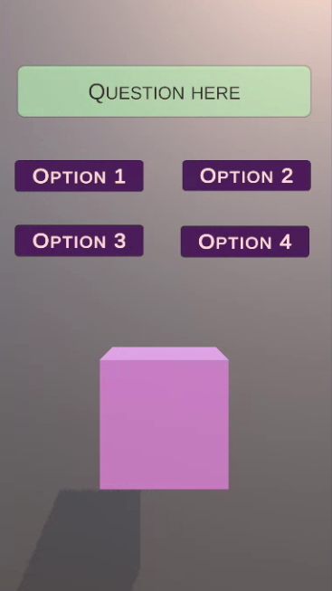
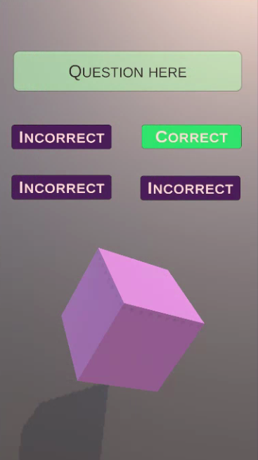
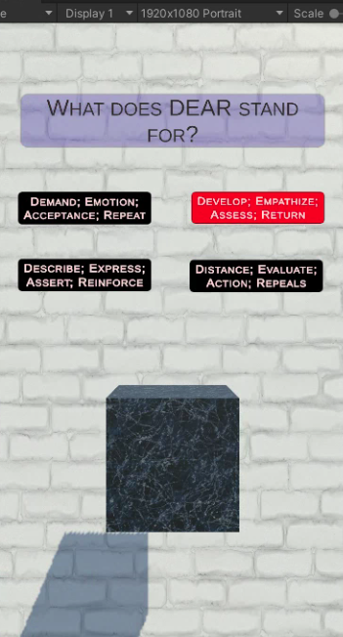
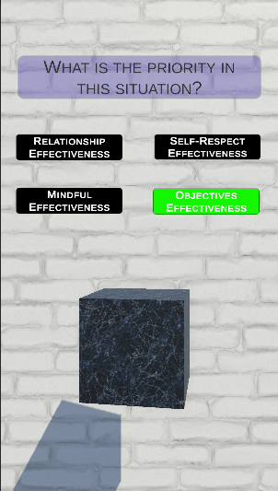
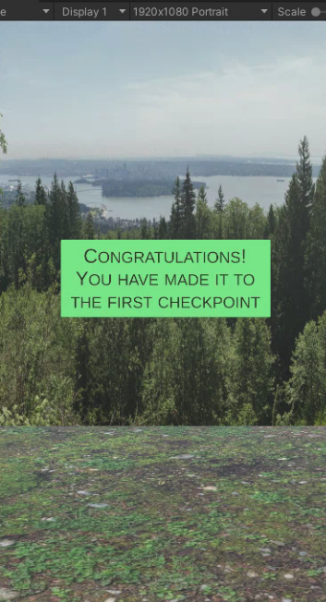
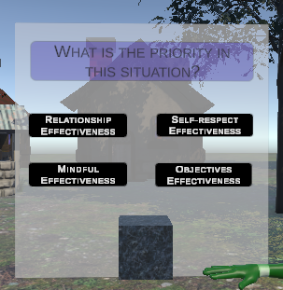
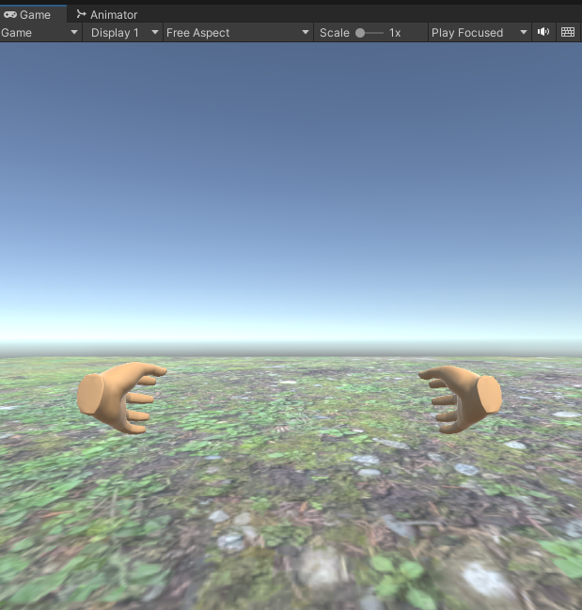
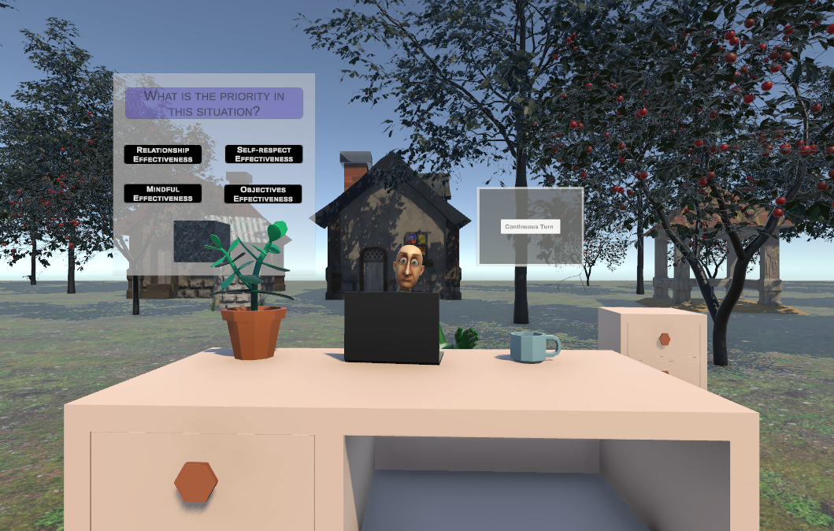
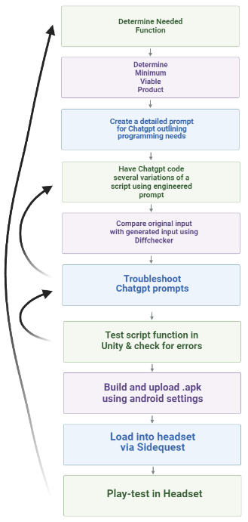
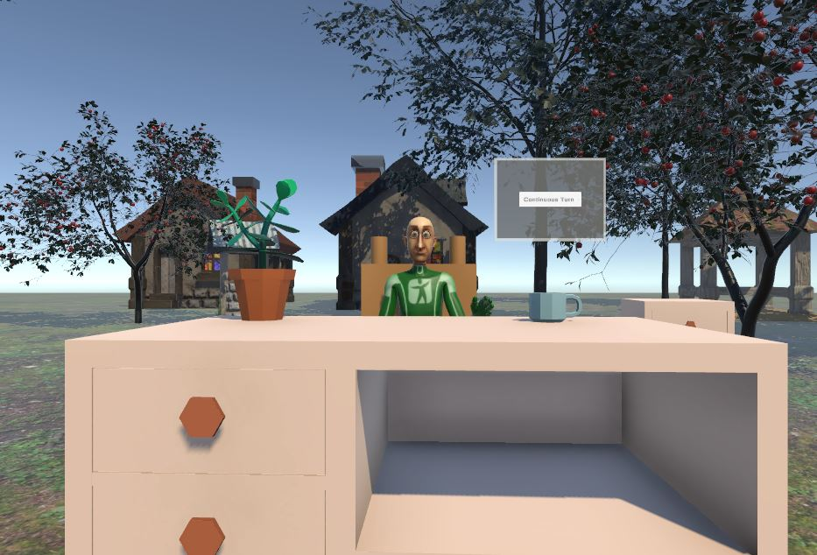
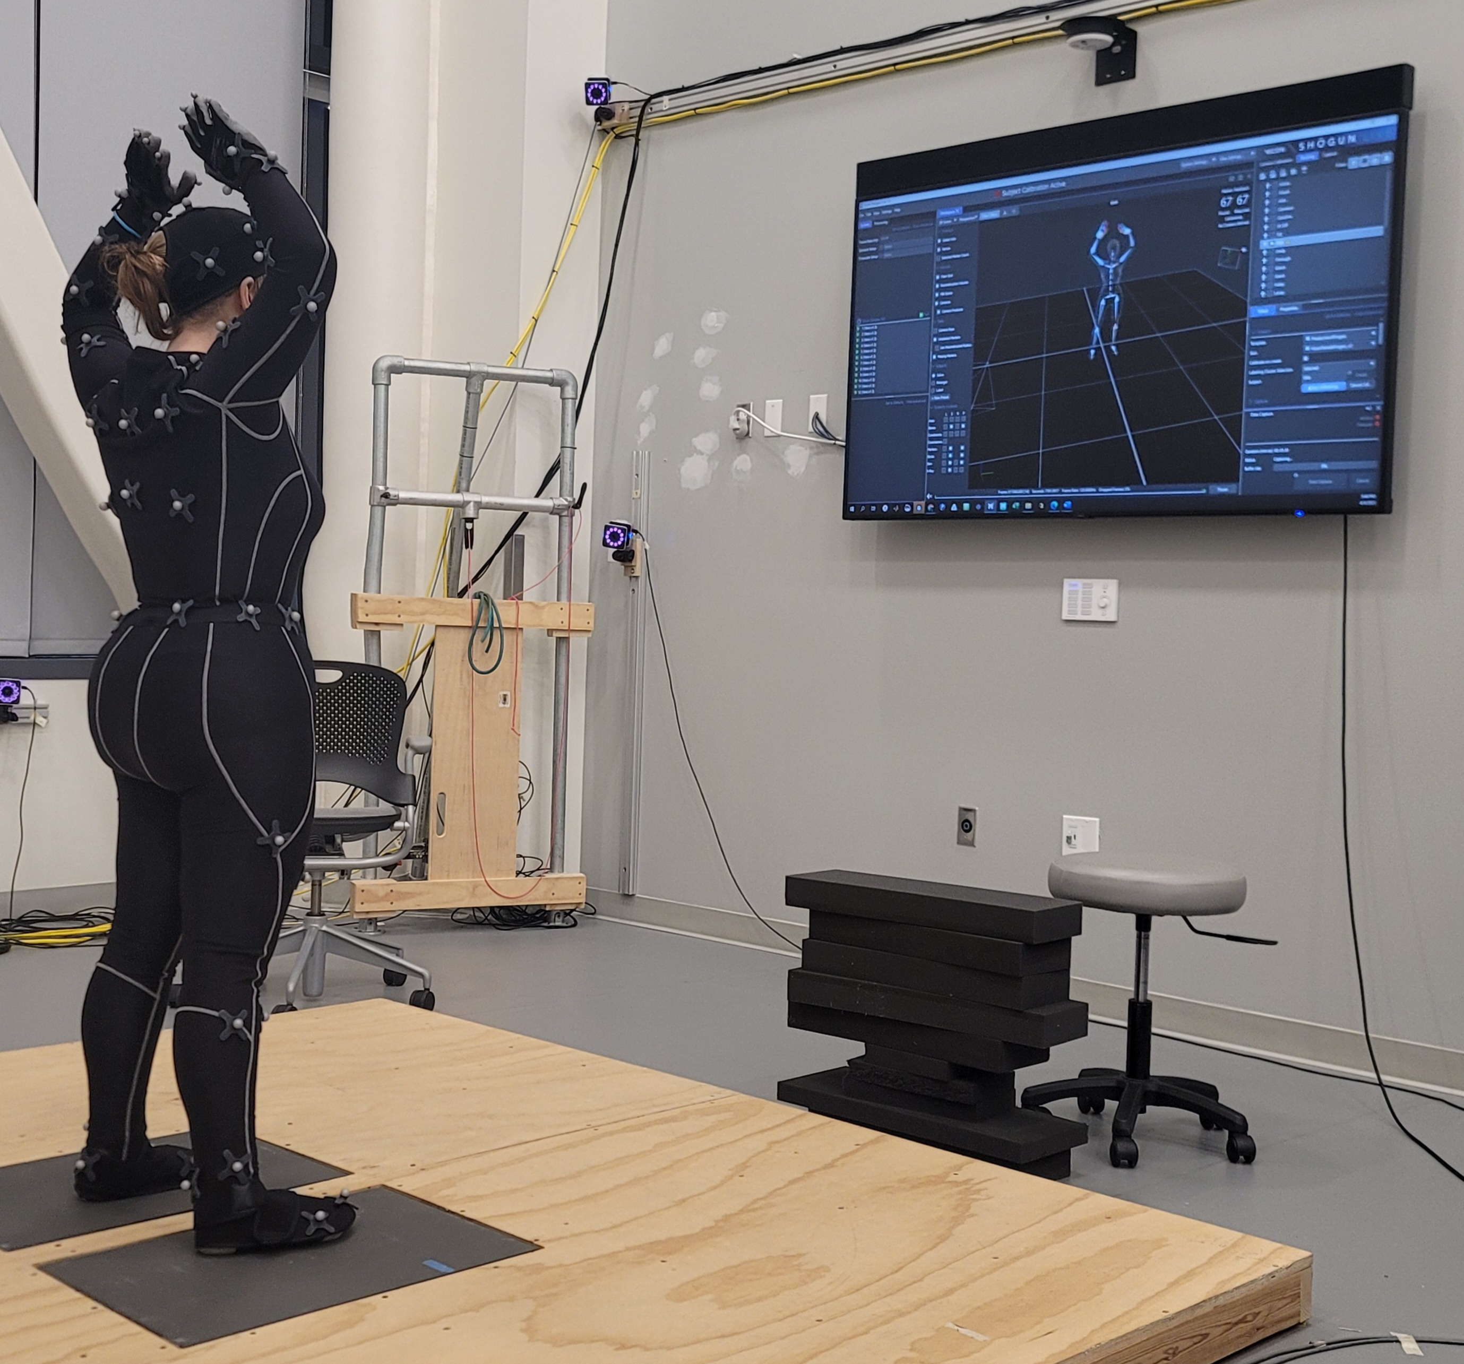
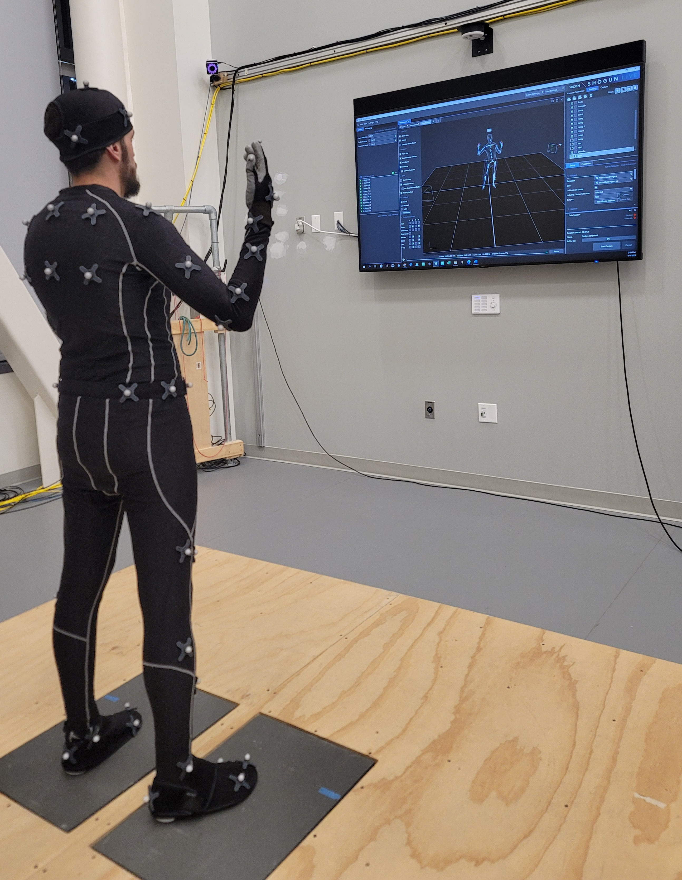
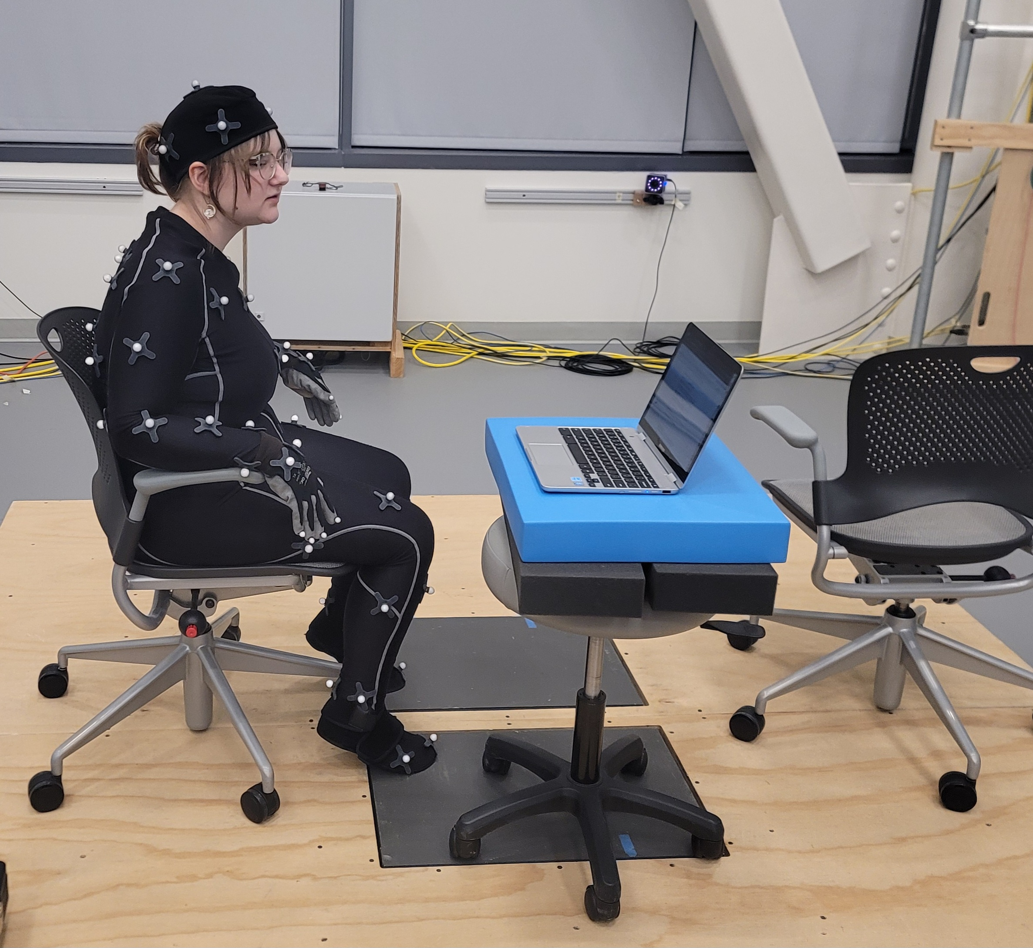
Developing Novel Therapeutics for Individuals with Autism Spectrum Disorder: Virtual Environments for Social and Emotional Learning
Elianna Bavuso, Silas Contaifer, Dayanjan Wijesinghe, PhD
Department of Pharmacotherapy and Outcome Sciences, Virginia Commonwealth University
Introduction
Current Status
Limitations
Autism Spectrum Disorder (ASD) is a complex neurodevelopmental disorder that can significantly impact an individual's social, communicative, and language skills (Mesa-Gresa et al., 2018; Dechsling et al., 2022; Ritschel et al., 2022; Bekele et al., 2013; Adjorlu et al., 2017). Individuals with ASD may experience deficits in emotional and social adaptation skills, which can hinder their ability to form and maintain friendships, regulate emotions, and respond appropriately to social cues (Golan, Baron-Cohen, & Hill, 2006). However, with appropriate interventions and support, individuals with ASD can learn social skills and strategies to navigate social situations successfully (Laugeson & Park, 2014).
College provides a structured environment that offers choices and control, which can benefit students with ASD, however, they may struggle with new social interactions and unfamiliar places, making it challenging for them to self-advocate and try new experiences without encouragement from others (Wenzel & Rowley, 2010). Autistic individuals commonly have lower quality peer friendships, lower acceptance by their classmates, and experience difficulties in social stimuli and unpredictable social environments (Dechsling et al., 2022). Additionally, the transition from school to work is challenging for many individuals with ASD, requiring individualized and need-driven services and supports (Hendricks & Wehman, 2009).
According to Jackson et al. (2018), post-secondary students with ASD often struggle with social integration, campus life, and mental health. The study found that over three-quarters of the students experienced difficulties with feelings of isolation, being left out, and lacking companionship. Furthermore, nearly three-quarters of the participants had some form of suicidal behavior over their lifetime (Jackson et al., 2018). Therefore, support services are crucial to ensure the success of this population in post-secondary academic settings.
Psychotherapeutic interventions have shown promise for improving outcomes in autistic adults. However, these interventions must be tailored to the specific needs of this population, taking into account their unique social, cognitive, and sensory features, as well as the presence of co-occurring mental health problems. One such intervention is dialectical behavior therapy (DBT), which aims to improve an individual's ability to regulate emotions effectively, with a particular focus on emotion dysregulation as a core deficit in individuals with a multi-diagnostic symptom presentation. Recent research suggests that DBT may be effective in reducing emotion dysregulation in autistic adults (Bemmouna et al., 2022).
Another form of dialectical behavior therapy that has shown promise for individuals with ASD is Radically Open Dialectical Behavior Therapy (RO-DBT), which targets maladaptive overcontrol, social isolation, and emotional expression. Recent research has found that RO-DBT was effective in reducing maladaptive overcontrol and improving social connectedness in both the general sample and the subsample with ASD, with improvements in depression and anxiety symptoms also observed in both groups (Cornwall et al., 2021).
However, to increase access to these interventions, it may be necessary to develop more scalable and cost-effective delivery methods. One promising avenue is the use of virtual reality (VR) software, which has been shown to be a feasible and acceptable intervention for autistic individuals in higher education (Parsons et al., 2017). It allows for repeated practice and exposure to dynamic and real-life social interactions in a safe and controllable manner (Mosher & Carreon, 2021; Kandalaft et al., 2013; Moore et al., 2005). One of the unique advantages of VR as a treatment approach for ASD is its ability to create a realistic and adaptable environment that caters to the individual characteristics and capabilities of the patient (Mesa-Gresa et al., 2018; Venkataramani et al., 2017). Researchers can create immersive and interactive scenarios that help students with ASD practice and improve their social skills in a controlled and safe environment using these technologies (Mosher & Carreon, 2021).
Though the use of innovative technologies such as augmented reality (AR) and virtual reality (VR) for social skill instruction in students with ASD is still considered an emerging field, there is strong evidence of its benefit for this group (Mosher & Carreon, 2021; Mesa-Gresa et al., 2018). Many studies have reported improvement in at least one objective addressed with VR-based treatment for ASD patients, with emotional and social skills being the most common clinical target (Mesa-Gresa et al., 2018). Learners are more motivated and engaged when serious games are incorporated in virtual reality learning, and individuals gain positive perspectives toward team cohesiveness, trust, and collaboration. Game-based activities promote positive verbal and nonverbal social interaction behaviors in adolescents with ASD compared to non-game activities (Wang & Xing 2022). Though hardware latency issues that cause motion sickness and vomiting need to be addressed, VR technology has shown to be more effective than other platforms in improving social communication skills, with VR head-mounted displays (HMDs) being particularly effective.
While more research is needed to fully understand the benefits and limitations of these approaches, the use of VR technology in treating ASD represents an innovative and promising approach that has the potential to address some of the challenges faced by individuals with ASD. This project aims to create VR conversational software for autism spectrum disorder for students in higher education that will provide a safe and controlled environment for students with ASD to practice and improve their social skills. The software will incorporate serious game design elements, such as collaborative role-playing, visual representation of achievement, and clear game goals to facilitate social competence learning and transferable social skills. By providing an interactive and engaging learning experience, the software has the potential to transform the way students with ASD learn social skills and improve their quality of life.
Our research project currently features a single, interactive scene designed to simulate a professor's outdoor office situated in a forested town. The professor character is animated with idle movements and maintains approximate eye contact with the user, providing a more realistic experience. The environment includes a variety of trees, multiple house shells, a well, a gazebo, a desk with a plant, laptop, and coffee cup, two desk chairs, and a male-presenting NPC.
To enhance the user's experience, we have added basic player controls, such as walking and two modes of turning (point turns and continuous turns) using the joysticks on the controllers. Additionally, we have developed an interaction mechanism with the professor through an opaque question/answer box located on the left side of the desk. This box allows the user to answer DBT-based questions and respond to limited dialogue options, enabling a more engaging and immersive experience. Our project is still in development, and we plan to add more interactive elements and features to the scene. However, we are excited about the progress we have made so far in creating an environment that simulates real-life scenarios in a controlled and safe virtual setting.
This project has a few limitations that need to be acknowledged. Firstly, the assets used are free and not specialized for their current purpose, which may cause occasional bugs in the beta software. Secondly, the current version that has been tested only includes a question set and not dialogue options. There is also no introduction to DBT Interpersonal effectiveness skills before completing the question set, which may be confusing for users without previous experience using DBT. Thirdly, the questions in the question set were written by the researcher in collaboration with Chatgpt and not a licensed psychologist, which may affect their accuracy. Fourthly, the conversational settings were determined by the researcher and may be subject to personal bias in terms of their relevance to the general student population. Finally, a majority of the pilot code was written using Chatgpt, as described in the methods section, which may result in over-complex or technically inefficient scripts in some cases. These limitations will be addressed in future iterations of the project.
Future Directions
Works Cited
The future directions for this project will involve several key steps to enhance the user experience and improve the overall functionality of the system. Firstly, the asset bundle Autohands will be added to the system to enable realistic grabbing capabilities and universal ability to grip differently shaped objects, which will significantly enhance the user's interaction with the scene. Secondly, colliders will be added to various small items within the scene to allow the user to interact with them, further improving the realism of the environment.
To create avatar meshes with realistic idle and conversational body language, the researchers have conducted motion capture with the Motor Control Lab in the Department of Physical Therapy using male and female models. The next phase of the project will involve importing these meshes into Unity and finding an appropriate texture to color them. To ensure that the avatars are representative of diverse identities, the researcher plans to collaborate with Semi Ryu in the Department of Kinetic Imaging in the VCU School of the Arts to create custom textures.
The researchers also aim to improve the conversational dialogue model by incorporating natural language processing (NLP) and machine learning methods following the established literature to create more realistic and engaging dialogue trees. To enhance the interactivity of the scene, the infrastructure will be programmed to allow the user to speak their answers into the microphone and receive appropriate responses from the conversational model.
Creating a user interface (UI) menu that appears upon loading the game will also be a key step, allowing users to select level difficulty and specifications for the nonplayer character (NPC) they will be interacting with. In addition, an educational scene explaining relevant DBT skills will be created and displayed before the conversational scene to help users better understand the context of the interaction. Overall, these steps will significantly enhance the user experience and make the system more engaging and interactive.
Adjorlu, A., Hoeg, E. R., Mangano, L., & Serafin, S. (2017). Daily Living Skills Training in Virtual Reality to Help Children with Autism Spectrum Disorder in a Real Shopping Scenario. In 2017 IEEE International Symposium on Mixed and Augmented Reality (ISMAR-Adjunct) (pp. 294–302). IEEE. https://doi.org/10.1109/ISMAR-Adjunct.2017.93
Bailey, B., Bryant, L., & Hemsley, B. (2021). Virtual reality and augmented reality for children, adolescents, and adults with communication disability and neurodevelopmental disorders: A systematic review. Review Journal of Autism and Developmental Disorders, 9(2), 160–183. https://doi.org/10.1007/s40489-020-00230-x
Bekele, E., Young, M., Zheng, Z., Swanson, A., Weitlauf, A. S., Warren, Z., & Sarkar, N. (2013). A Step towards Adaptive Multimodal Virtual Social Interaction Platform for Children with Autism. In Universal Access in Human-Computer Interaction. User and Context Diversity (pp. 464–473). Springer Berlin Heidelberg. https://doi.org/10.1007/978-3-642-39191-0_51
Bemmouna, D., Coutelle, R., Weibel, S., & Weiner, L. (2022). Feasibility, acceptability and preliminary efficacy of dialectical behavior therapy for autistic adults without intellectual disability: A mixed methods study. Journal of Autism and Developmental Disorders, 52(10), 4337-4354. https://doi.org/10.1007/s10803-021-05317-w
Chen, C.-H., Lee, I.-J., & Lin, L.-Y. (2016). Augmented reality-based video-modeling storybook of nonverbal facial cues for children with autism spectrum disorder to improve their perceptions and judgments of facial expressions and emotions. Computers in Human Behavior, 55, 477–485. https://doi.org/10.1016/j.chb.2015.09.033
Cheng, Y., Huang, C.-L., & Yang, C.-S. (2015). Using a 3D Immersive Virtual Environment System to Enhance Social Understanding and Social Skills for Children With Autism Spectrum Disorders. Focus on Autism and Other Developmental Disabilities, 30(4), 222–236. https://doi.org/10.1177/1088357615583473
Cornwall, P. L., Simpson, S., & Meaden, A. (2018). Evaluation of radically open dialectical behaviour therapy in an adult community mental health team: Effectiveness in people with autism spectrum disorders. Journal of Psychiatric and Mental Health Nursing, 25(1), 13–24. https://doi.org/10.1111/jpm.12420
Dechsling, A., Orm, S., Kalandadze, T., et al. (2022). Virtual and augmented reality in social skills interventions for individuals with autism spectrum disorder: A scoping review. Journal of Autism and Developmental Disorders, 52(11), 4692–4707. https://doi.org/10.1007/s10803-021-05338-5
Fast, Y. (2004). Employment for Individuals with Asperger Syndrome or Non-Verbal Learning Disability: Stories and Strategies (1st ed.). Jessica Kingsley Publishers.
Grynszpan, O., Weiss, T. P., Perez-Diaz, F., & Gal, E. (2014). Innovative technology-based interventions for autism spectrum disorders: A meta-analysis. Autism: The International Journal of Research and Practice, 18(4), 346–361. https://doi.org/10.1177/1362361313476767
Hendricks, D. R., & Wehman, P. (2009). Transition From School to Adulthood for Youth With Autism Spectrum Disorders: Review and Recommendations. Focus on Autism and Other Developmental Disabilities, 24(2), 77–88. https://doi.org/10.1177/1088357608329827
Ip, H. H. S., Wong, S. W. L., Chan, D. F. Y., Byrne, J., Li, L. S. W., Fung, D. S. S., & Chung, R. C. K. (2018). Enhance Emotional and Social Adaptation Skills for Children with Autism Spectrum Disorder: A Virtual Reality Enabled Approach. Computers & Education, 117, 1–15. https://doi.org/10.1016/j.compedu.2017.09.010
Jackson, S. L. J., Hart, L., Brown, J. T., & Volkmar, F. R. (2018). Brief report: Self-reported academic, social, and mental health experiences of post-secondary students with autism spectrum disorder. Journal of Autism and Developmental Disorders, 48(3), 643–650. https://doi.org/10.1007/s10803-017-3315-x
Jaliaawala, M. S., & Khan, R. A. (2020). Can autism be catered with artificial intelligence-assisted intervention technology? A comprehensive survey. The Artificial Intelligence Review, 53(2), 1039–1069. https://doi.org/10.1007/s10462-019-09686-8
Kandalaft, M. R., Didehbani, N., Krawczyk, D. C., Allen, T. T., & Chapman, S. B. (2013). Virtual reality social cognition training for young adults with high-functioning autism. Journal of Autism and Developmental Disorders, 43(1), 34–44. https://doi.org/10.1007/s10803-012-1544-6
Lorenzo, G., Lledó, A., Pomares, J., & Roig, R. (2016). Design and Application of an Immersive Virtual Reality System to Enhance Emotional Skills for Children with Autism Spectrum Disorders. Computers & Education, 98, 192–205. https://doi.org/10.1016/j.compedu.2016.03.018
Mesa-Gresa, P., Gil-Gomez, H., Lozano-Quilis, J.-A., & Gil-Gomez, J.-A. (2018). Effectiveness of virtual reality for children and adolescents with autism spectrum disorder: An evidence-based systematic review. Sensors, 18, 2486. https://doi.org/10.3390/s18082486
Moore, D., Cheng, Y., McGrath, P., & Powell, N. J. (2005). Collaborative virtual environment technology for people with autism. Focus on Autism and Other Developmental Disabilities, 20(4), 231–243. https://doi.org/10.1177/10883576050200040501
Mosher, M. A., & Carreon, A. C. (2021). Teaching social skills to students with autism spectrum disorder through augmented, virtual and mixed reality. Research in Learning Technology, 29, 1–22. https://doi.org/10.25304/rlt.v29.2626
Ritschel, L. A., Guy, L., & Maddox, B. B. (2022). A pilot study of dialectical behavior therapy skills training for autistic adults. Behavioural and Cognitive Psychotherapy, 50(2), 187-202. https://doi.org/10.1017/S1352465821000370
Roberts, K. D. (2010). Topic areas to consider when planning transition from high school to postsecondary education for students with autism spectrum disorders. Focus on Autism and Other Developmental Disabilities, 25(3), 158-162. https://doi.org/10.1177/1088357610371476
Venkataramani, G. P., Sankaranarayanan, K., Mukherjee, S., Arputharaj, K., & Sankara Narayanan, S. (2017). A rehabilitation therapy for autism spectrum disorder using virtual reality. In Smart Secure Systems - IoT and Analytics Perspective (Vol. 808, pp. 328-336). Springer Singapore Pte. Limited. https://doi.org/10.1007/978-981-10-7635-0_26
Wang, X., & Xing, W. (2022). Supporting youth with autism learning social competence: A comparison of game-and nongame-based activities in 3D virtual world. Journal of Educational Computing Research, 60(1), 74-103. https://doi.org/10.1177/07356331211022003
Wenzel, C., & Rowley, L. (2010). Teaching social skills and academic strategies to college students with Asperger’s syndrome. Teaching Exceptional Children, 42(5), 44-50. https://doi.org/10.1177/004005991004200505
Wolf, L., Brown, J. T., & Bork, G. (2011). Students with Asperger syndrome: A guide for college personnel. Journal of Autism and Developmental Disorders, 41(9), 1289-1290. https://doi.org/10.1007/s10803-010-1122-8
Methodology
This section describes an ongoing work on a larger VR-based adaptive intervention system for adaptive multimodal social interaction.
Hardware Environment
The software was developed for the Meta Quest 2, because the lab already had access to them, they’re a free-standing design which allows access anywhere, and they are compatible with the android system, which is generally considered easier to work with in developing software than IOS. The original iterations of the software were designed for and tested by android phones.
Software Environment
The VR task presentation engine was built in popular game engine Unity3D vers 2021.3.15f1, utilizing the Android, UWP, and Windows modules. The project was coded in C# in Visual Studio 2017, and used a combination of human and AI-generated code (Chatgpt vers 3.23.23) to create the scripts necessary for the software to function. Iterations of coding scripts were compared using diffchecker.com so the researcher could make sure all necessary libraries and comments were copied over into the new interaction of the script.
Content Design
The researcher used an iterative design process which involved the modular development of features based on the Minimum Viable Product school of thought. Essentially, the system developed in various stages and usability studies are performed at different milestones.
The study used a situational learning environment that emphasizes the application of learning to real-world situations, and the VR system allowed for exploration and involvement with social events. Four social settings with three sublevels were proposed: Interacting with a professor, a grocery store, a restaurant, and a job interview. As the target audience is students in higher education, the researcher felt it was appropriate to begin with the Professor scene. The question set used in the scene was written based on Interpersonal Effectiveness Handouts 4-5 (“Clarifying Goals in Interpersonal Situations, “Guidelines for Objectives Effectiveness: Getting What You Want”) from DBT Skills Training Handouts and Worksheets, Second Edition, by Marsha Linehan (2015).
Fig. 2. Shows the development of the question set mechanism, which was originally programmed to function as an android app. The first two photos demonstrate the recognition of a correct and incorrect answer and the software responding accordingly by changing the color of the text box and spinning the cube. The third and fourth photos demonstrate a question and set of answers loaded into the question-and-answer buttons from a .csv file (created in Google Sheets) that are correctly labeled as correct or incorrect. The fifth photo shows the checkpoint scene that is displayed if you successfully answer all the questions correctly.
Setting | Difficulty | Tasks to Complete
Professor | Easy | Ask a question after class
Professor | Medium | Request to use an accommodation during office hours
Professor | Hard | Request a letter of recommendation
Grocery Store | Easy | Check out and interact with the cashier
Grocery Store | Medium | Ask an employee for help finding an item
Grocery Store | Hard | Run in with someone you knew from high school
Restaurant | Easy | Place your order
Restaurant | Medium | Flag waiter down for an item
Restaurant | Hard | Send an incorrect meal back
Job Interview | Easy | Ask to be a reference
Job Interview | Medium | 1 on 1 interview
Job Interview | Hard | Group interview
Fig. 3. Shows the development of the virtual scene. The first photo demonstrates the creation of the question set in 3D, with the ability to interact with the buttons via ray-cast. The second photo shows the creation of functional hands in the virtual scene that had the ability to pinch and grab. The third photo demonstrates the first functional iteration of the town scene with an avatar that had idle movement animations and maintained approximate eye contact. The fourth photo shows the current iteration of the scene complete with the question/answer box and small detail items such as desk chairs and the professor’s laptop.
Acknowledgements
Thank you to the Undergraduate Fellowship for Clinical and Translational Research (CCTR), the Department of Pharmacotherapy and Outcomes Sciences, and the Motor Control Lab in the Department of Physical Therapy. Special thank you to Silas Contaifer and Dr. Wijesinghe for their support and mentorship on this project, as well as Cameron Krainock for his assistance in doing the motion capture.
Table 1. Describes the four potential settings proposed and the tasks needed to complete each level.
Fig. 1. Describes the methods for creating and implementing functions into the project
Fig. 4. Shows the process of calibrating and recording the motion capture data used to create the mesh and animations for the Professor NPCs. The virtual environment was simulated to the best of the researcher’s ability with physical objects, and a script was performed between the two participants while capturing data to promote use of natural body language markers in the animations.

